Slide 1

Federated Learning in Cybersecurity: Applications and Challenges
Beibei Li
Jan. 20, 2022
College of Cyber Science and Engineering, Sichuan University, P.R. China

Slide 2
Federated Learning in Cybersecurity: Applications and Challenges
Security Challenges in Federated Learning:
Byzantine Attack and Defense
FLPhish: Reputation-based Phishing Byzantine Defense in Ensemble Federated Learning
Beibei Li, Peiran Wang, Hanyuan Huang, Shang Ma, and Yukun Jiang
Best Paper Award in IEEE symposium on Computers and Communications’ 2021

Slide 3
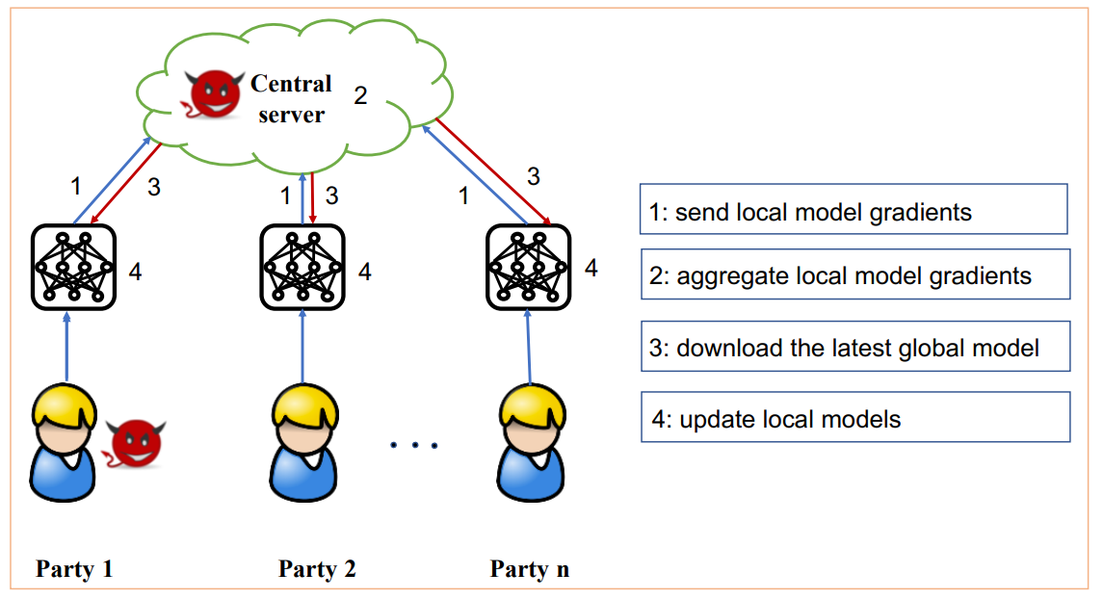
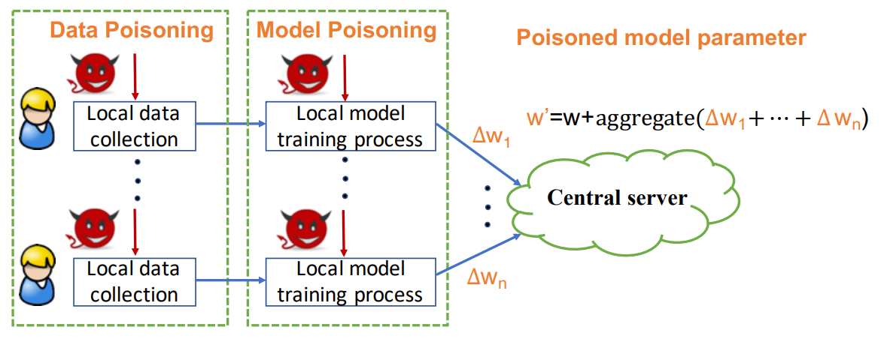
Federated Learning Faces Byzantine Threat
Typical Federated Learning (called FL) faces challenges from Byzantine attackers:
Malicious Byzantine attackers can launch attacks in two major way:
Data Poisoning Attack: Data poisoning attack is launched during local data collection by label flipping attacks etc.
Model Poisoning Attack: model poisoning attack is launched during local model training process
The intention of the attack is to violate central model
Lyu, Lingjuan, Han Yu, and Qiang Yang. "Threats to federated learning: A survey." arXiv preprint arXiv:2003.02133 (2020).

Slide 4
Draw backs of typical FL architecture
Traditional FL has many drawbacks:
Heavy network cost
Each FL client should use the same type of deep learning model, such as CNN, LSTM ...
Vulnerable to malicious Byzantine attacks

Slide 5


Our architecture
FL Client:
Collect local data
Train a local model
Make predictions of the broadcast dataset
Transfer the predictions back to the FL server
FL Server:
Preserve a public dataset
Broadcast the public dataset
Receive the predictions of the public dataset
Aggregate the predictions of the public dataset

Slide 6
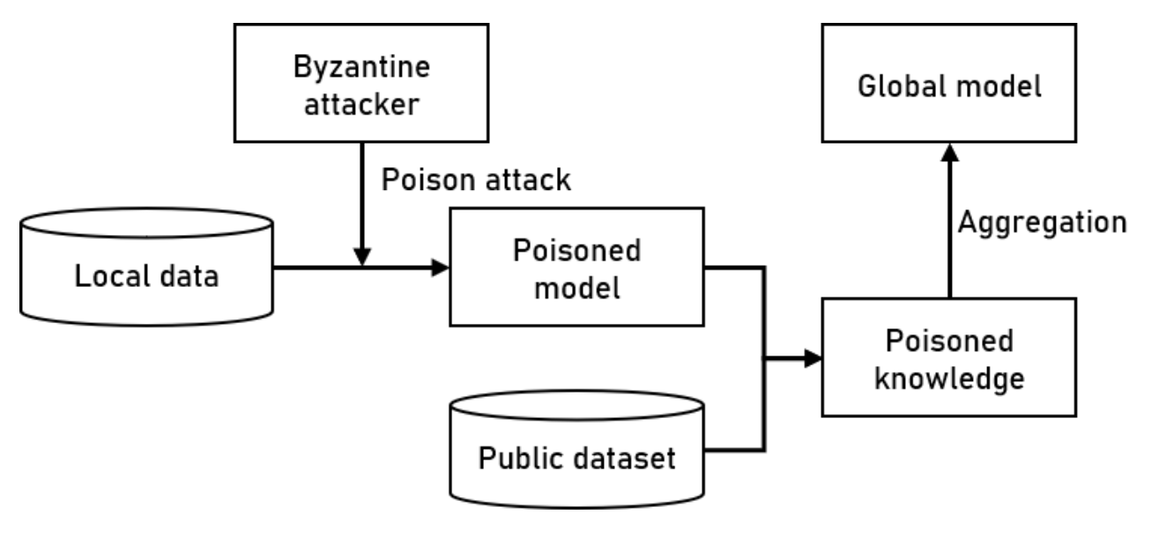
Attacks in Ensemble FL

Slide 7
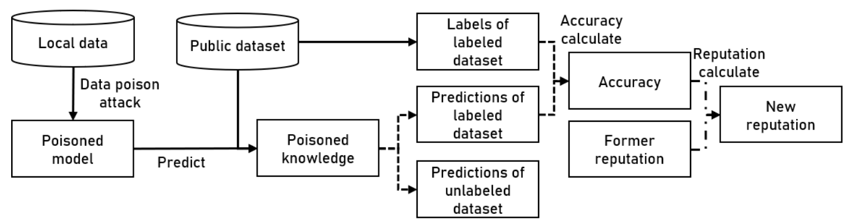
FLPhish

Slide 8
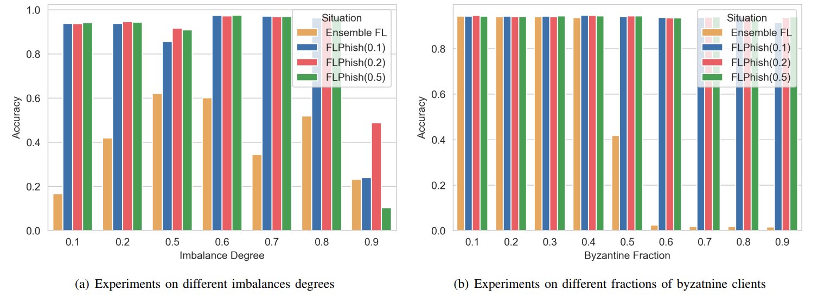
Experiments Results

Slide 9
Conclusions
First, we propose a novel reputation-based phishing scheme, called FLPhish, which can effectively defend against Byzantine attacks in Ensemble FL.
Second, we design a new Ensemble FL architecture, which utilizes an unlabeled dataset and the clients’ predictions to update the global model. This architecture allows implementation of various deep learning models in each client, which makes FL more flexible.
Third, we craft a robust phishing mechanism for the Ensemble FL architecture to identify Byzantine attacks, where a predefined labeled dataset is employed to detect the potential Byzantine clients who will make wrong predictions about the labeled dataset in Ensemble FL.

Slide 10
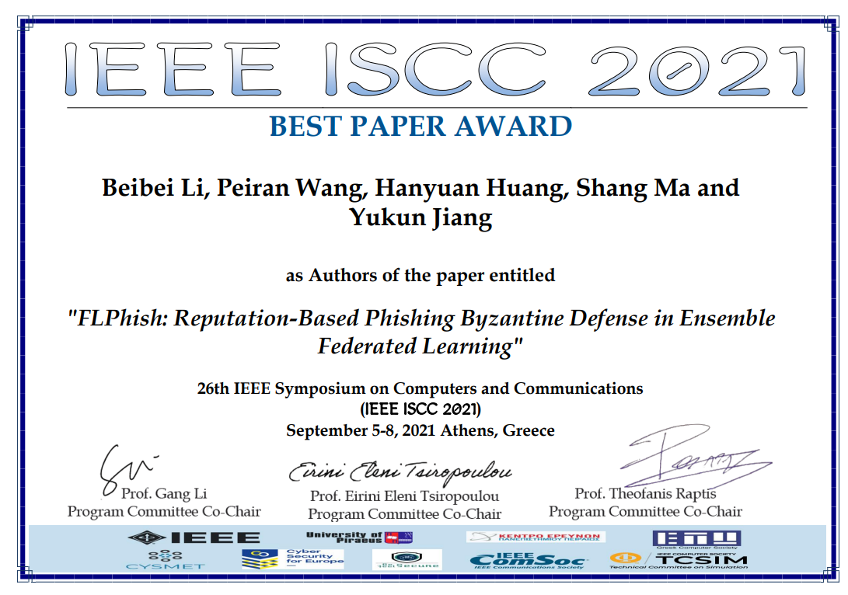
Best Paper Award in IEEE ISCC 2021

Slide 11
Federated Learning in Cybersecurity: Applications and Challenges
Federated Learning Application in Cybersecurity:
Intrusion Detection in Industrial Cyber-Physical Systems
DeepFed: Federated Deep Learning for Intrusion Detection in Industrial Cyber–Physical Systems
Beibei Li, Yuhao Wu, Jiarui Song, Rongxing Lu, Tao Li, and Liang Zhao
ESI Highly Cited Paper, IEEE Transactions on Industrial Informatics

Slide 12
Ⅰ. Introduction
ICPSs: Industrial Cyber-Physical Systems (ICPSs) are large-scale, geographically dispersed, federated, heterogeneous, life-critical systems that comprise sensors, actuators, and control and networking components. These systems have multiple control loops, strict timing requirements, predictable network traffic, legacy components, and possibly wireless network segments.
Vulnerabilities of ICPSs: Many industries exist in ICPS with inherent security vulnerabilities can be exploited. It give a sophisticated adversary the possibility to launch attacks. If it is serious, it may cause the network of industries to immediately disrupt the concerned processes to a catastrophe.
Cause there are many threaten exist in ICPS, it is necessary to to do some research on intrusion detection in data privacy protection and multiple attack detection than ever before.
Notes:
e.g. Smart grids, unmanned aircraft systems.

Slide 13
Ⅰ. Introduction
Existing Problems in Intrusion Detection for ICPSs:
High quality and large quantities of training data are often hard to get and cannot be easily shared and transmitted.
The owner of some highly sensitive data will also strongly object to the unrestricted calculation and use of the data, in which case, the data owner will only allow the data to be kept in his own hands, thus creating separate islands of data.
Federated Learning:
Federated learning is a machine learning technique that trains an algorithm across multiple decentralized edge devices or servers holding local data samples, without exchanging their data samples.
Motivation of Federated Learning:
Machine learning or deep learning models can be trained by each data owner, then with the help of cloud server, a global model can be obtained through model aggregation.
If only parameters were transferred between the device and the the communication would be extremely efficient.
It can maximize the computing power of terminal devices in cloud systems.
Notes:
The process of exchanging model parameters between participants will be carefully designed so that third parties on communication channels and aggregated models cannot guess the private data content of any other organization.

Slide 14
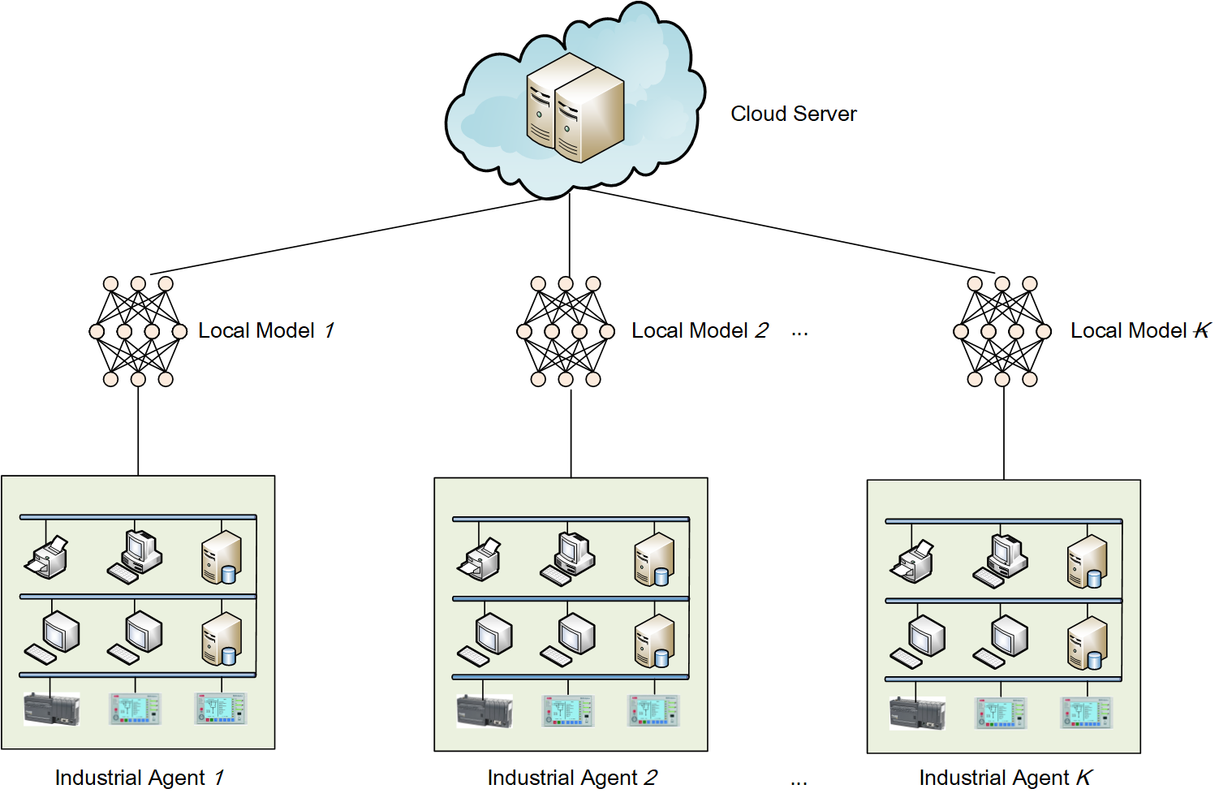
Ⅱ. System Model and Threat Model
A. System Model:
The considered system consist of k industrial agents and a cloud server.
Industrial agents, owners of ICPSs, with the same network traffic data structure that demand for collaboratively learning a deep learning model for intrusion detection .
A cloud server that aggregates intrusion detection models trained by industrial agents in the system.

Slide 15
Ⅱ. System Model and Threat Model
B. Threat Model:
Industrial agents are exposed to many severe threats:
Reconnaissance attacks
Response injection attacks
Command injection attacks
Denial-of service attacks
Threats during collaboratively model training:
Leakage of industrial agents’ data
Leakage of industrial agents’ model parameters
Assumptions:
All industrial agents are honest, so that agents follow the negotiated rules and they share the final model parameters. Since all industrial agents train models locally, there is no risk of industrial agents’ data leakage in the system.
The cloud server is semi-honest, namely honest but curious, in that it perform the actions correctly, but attempt to obtain model parameters of industrial agents. Hence, no leakage of parameters from any industrial agents to the server is allowed.

Slide 16
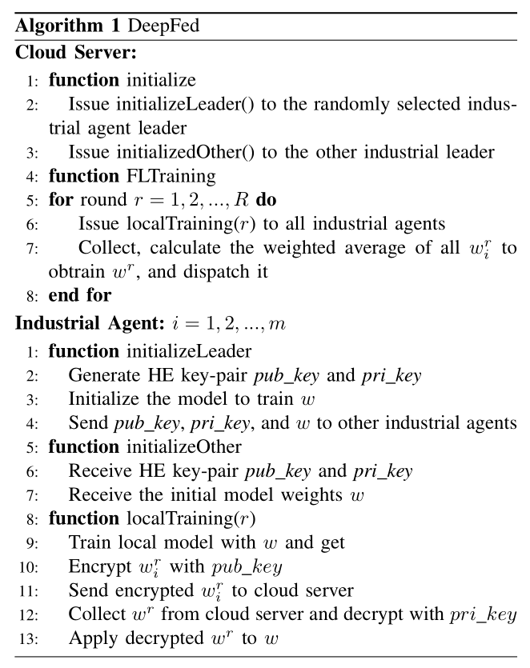
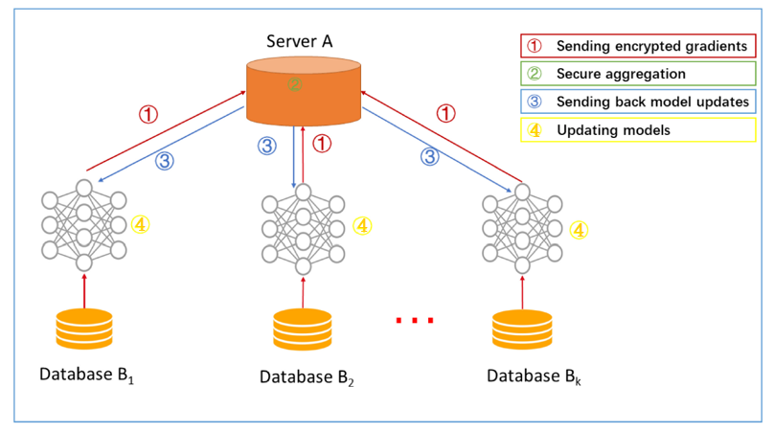
Ⅲ. The Proposed DeepFed Scheme
A. Framework of DeepFed:
Industrial agents jointly train a deep learning model for intrusion detection using federated learning.
Notes:
Industrial agents jointly train a deep learning model for intrusion detection using federated learning. The whole process is divided into communication rounds. Each communication round contains the following four steps:
Step 1: Locally train by industrial agents (homomorphic encryption: encrypt).
Step 2: Secure aggregated by server, a central model is obtained.
Step 3: Aggregated results are sent back to industrial agents.
Step 4: Respective models of industrial agents are updated (homomorphic encryption: decrypt).
Iterations until the loss function converges, thus completing the entire training process.

Slide 17
Ⅲ. The Proposed DeepFed Scheme
B. CNN-GRU Model for Intrusion Detection:
Model Architecture: The proposed CNN-GRU model is mainly composed by a CNN (convolutional neural network) module and a GRU (gated recurrent unit) module, followed by a MLP (multilayer perceptron) module, and then a softmax layer.

Slide 18
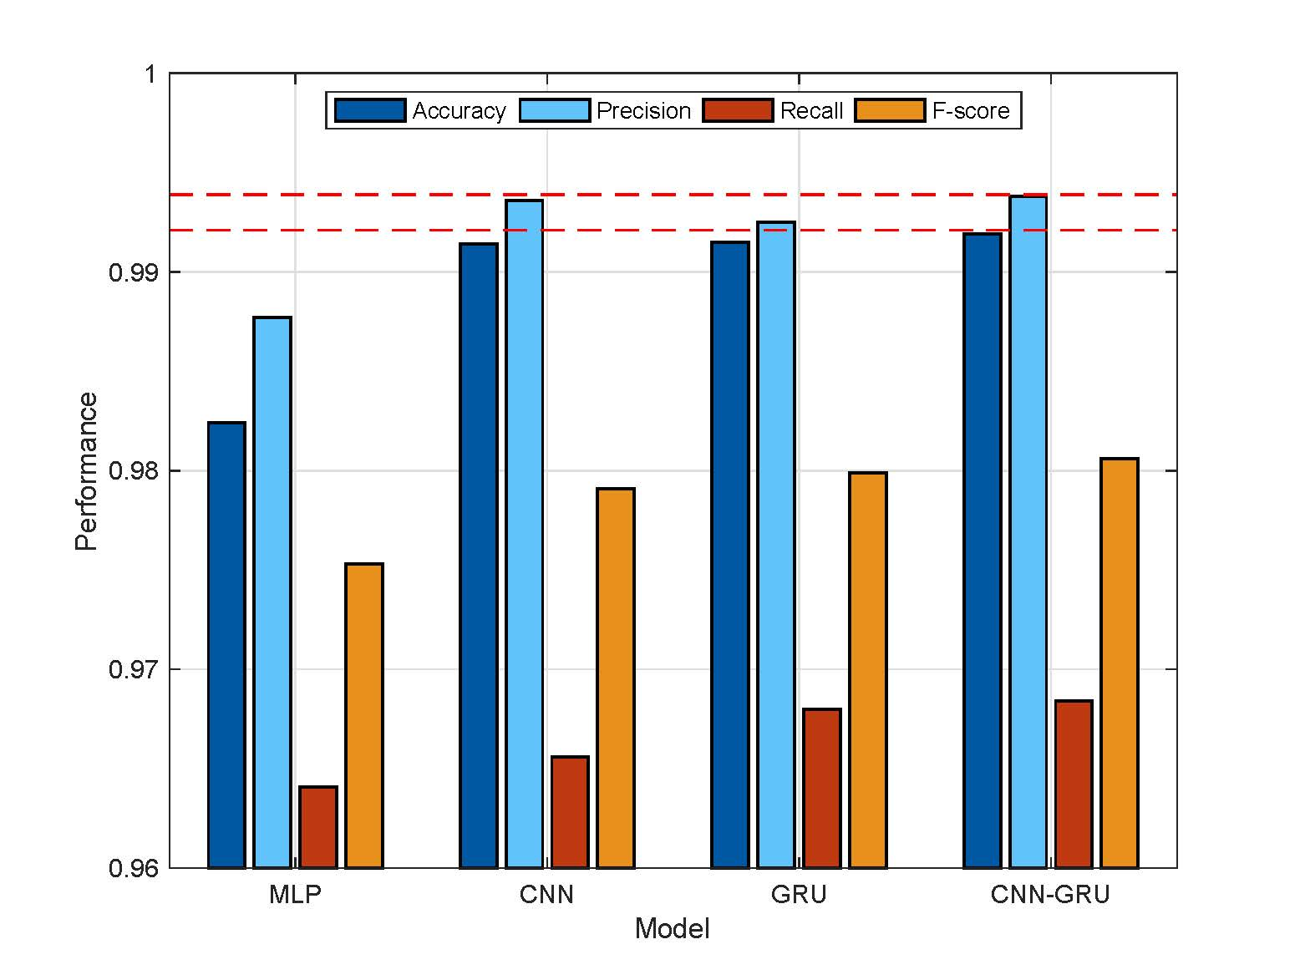
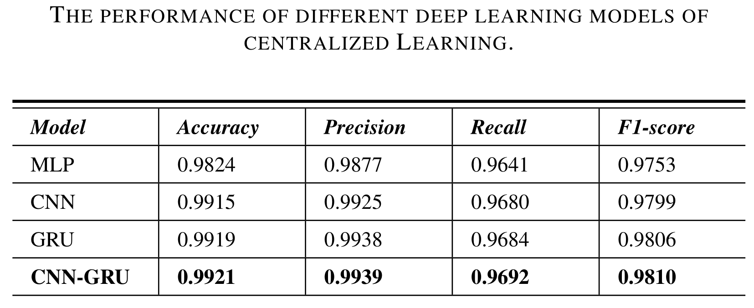
Ⅳ. Experiments and Evaluation
A. Performance Comparison Under Centralized Learning: The performance of different deep learning models of centralized Learning.

Slide 19
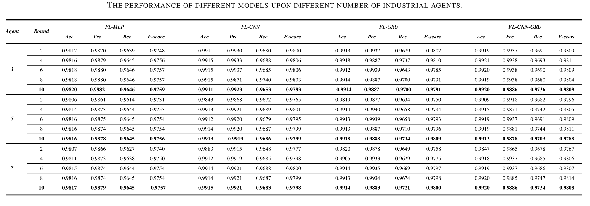
Ⅳ. Experiments and Evaluation
B. Performance Comparison upon Federated Learning: The performance of different models, including FL-MLP, FL-CNN,FL-GRU and FL-CNN-GRU, upon different number of industrial agents.

Slide 20
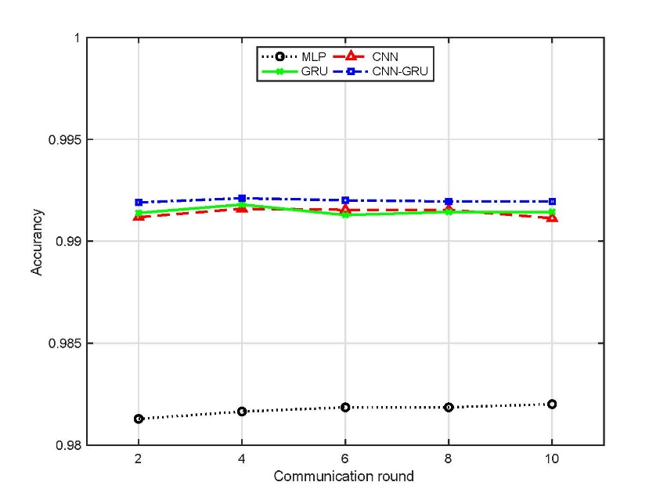
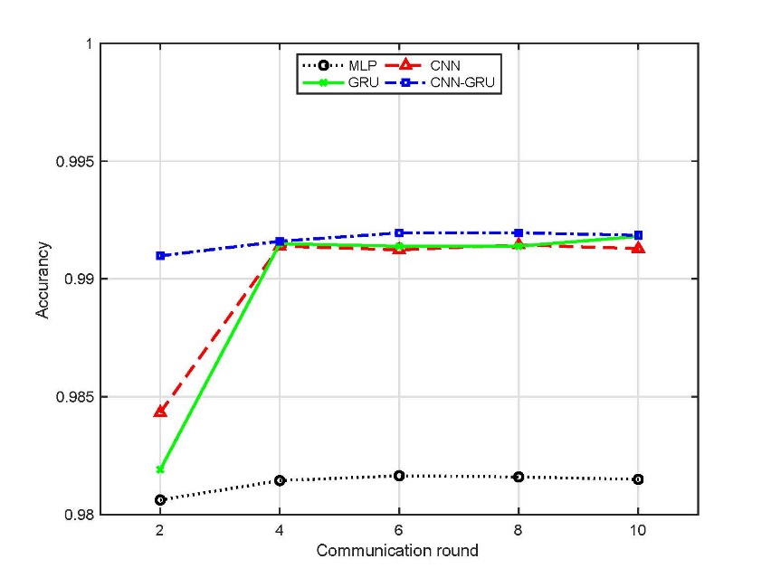
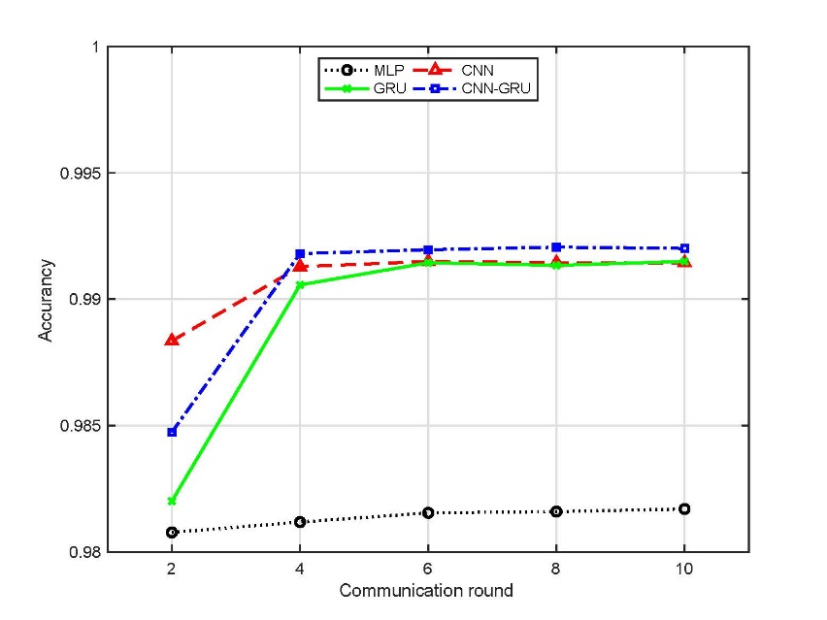
Ⅳ. Experiments and Evaluation
B. Performance Comparison upon Federated Learning: The accuracy of different models upon different communication rounds in three scenarios (3 agents, 5 agents, 7 agents, respectively).

Slide 21
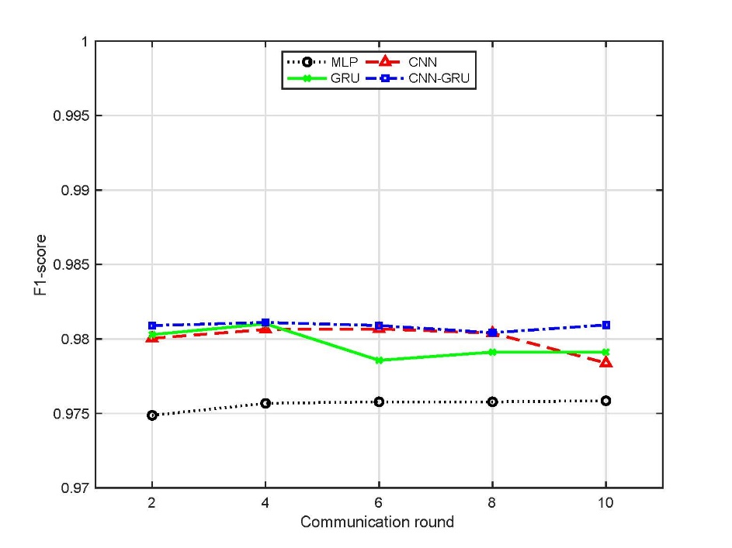
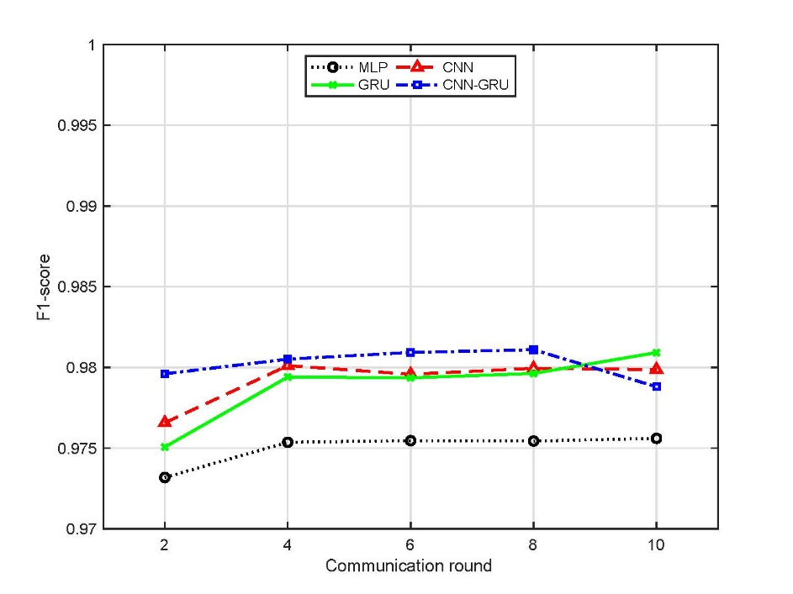
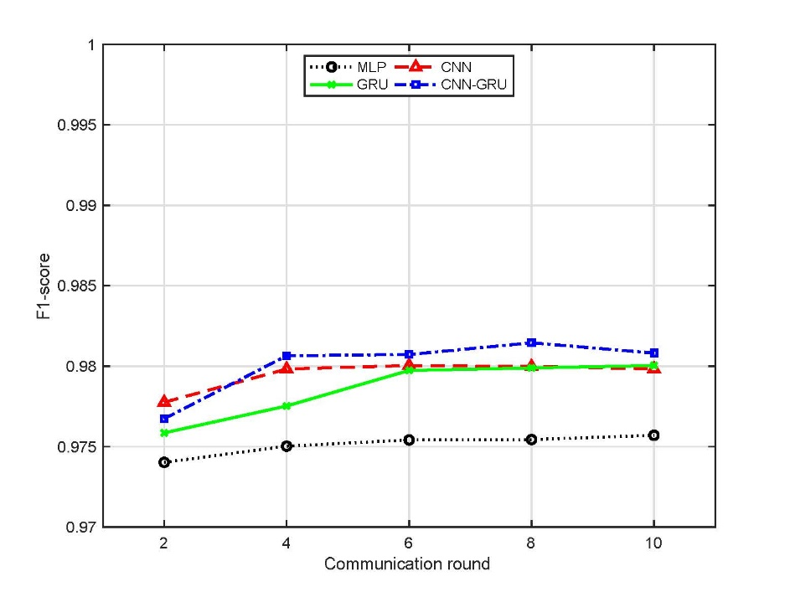
Ⅳ. Experiments and Evaluation
B. Performance Comparison upon Federated Learning: The F-score of different models upon different communication rounds in three scenarios (3 agents, 5 agents, 7 agents, respectively).

Slide 22
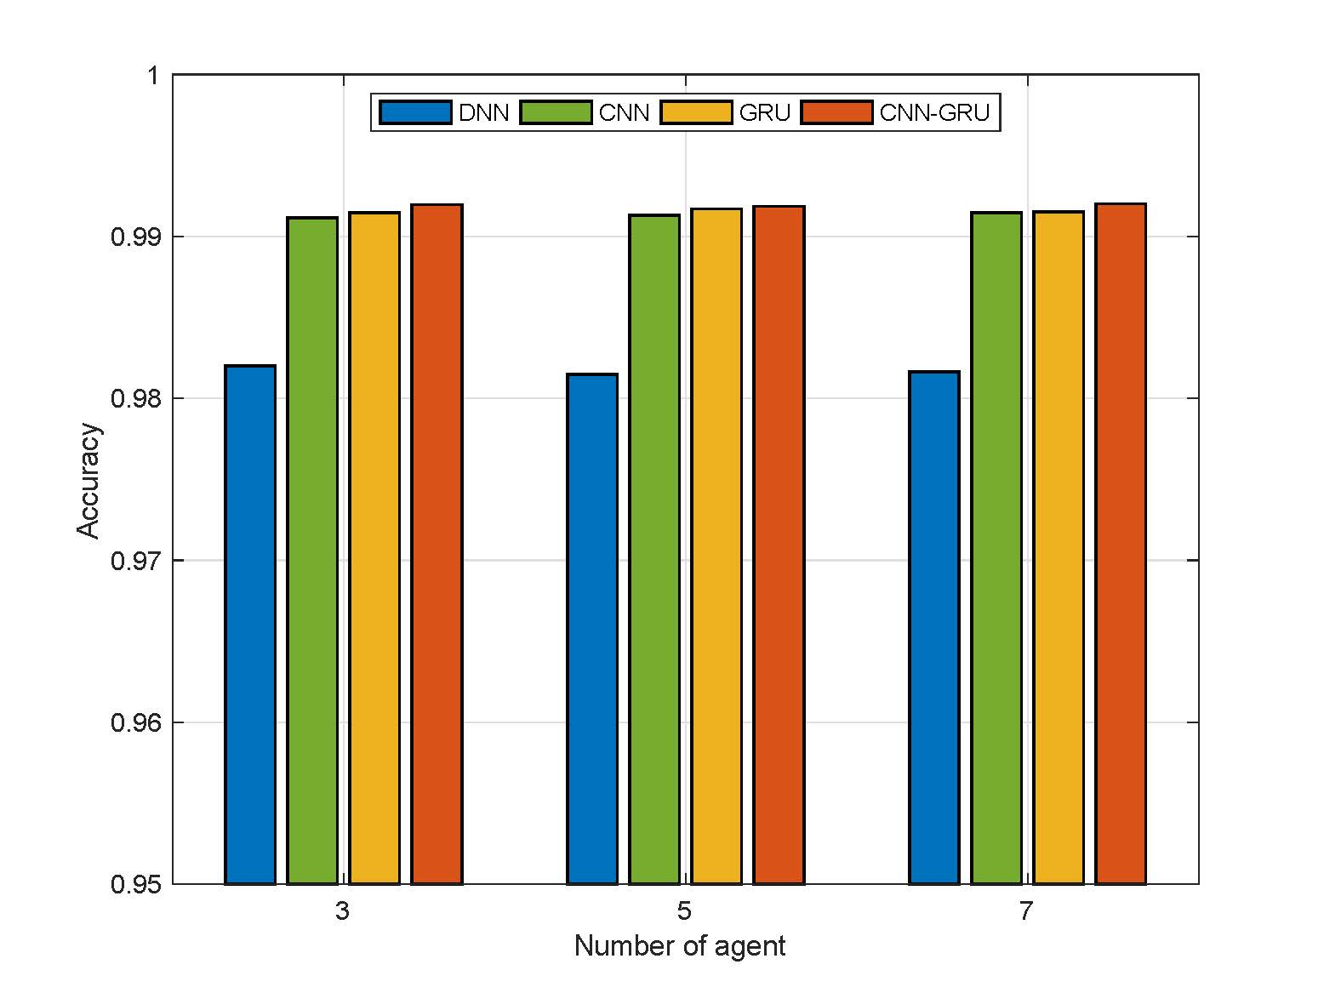
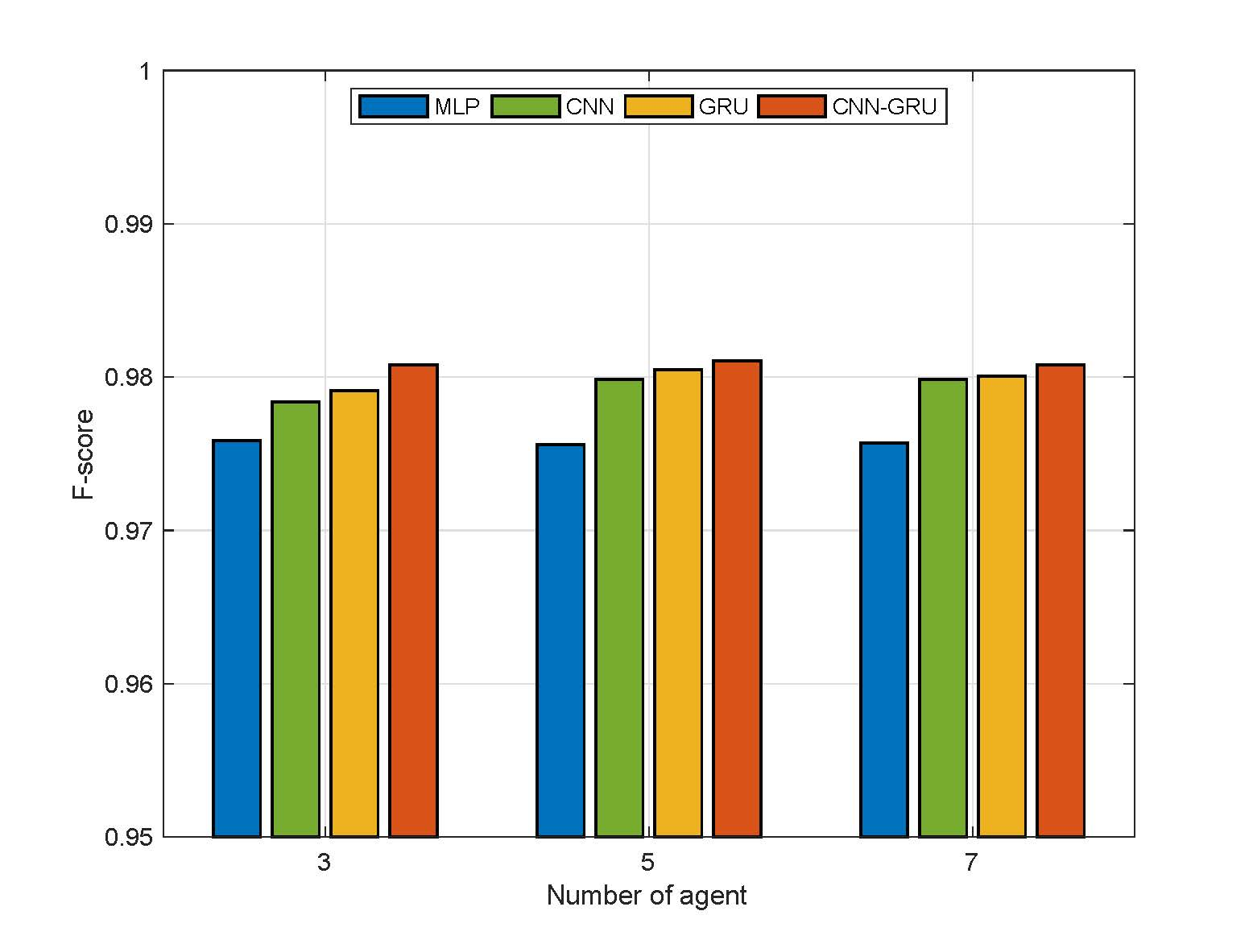

Ⅳ. Experiments and Evaluation
B. Performance Comparison upon Federated Learning: The accuracy and F-score of different models after ten communication rounds in three scenarios (3 agents, 5 agents, 7 agents, respectively).

Slide 23
Ⅳ. Experiments and Evaluation
C. Federated Learning Versus Centralized Learning
We observe that the model generally perform better in the centralized learning mode than in the federated learning mode. The reduction in performance of the federated learning compared to centralized learning is within the acceptable range. It would be wise to trade a little precision for helping industry agents exist in ICPS to protect the data privacy.

Slide 24
Ⅴ. Conclusion
First, a novel deep learning-based intrusion detection scheme, namely DeepFed is proposed for ICPSs, which can identify multiple attacks existing in ICPSs.
Second, federated learning is employed to jointly train a deep learning model with good performance that takes advantages of CNN and GRU. Meanwhile, data privacy of industrial agents can be protected during the collaborative training process.
Third, model parameters of all industrial agents are preserved by using homomorphic encryption, so that model parameter leakage can be avoided during the communication between industrial agents and cloud server.

Slide 25
Appreciation
Your efforts are Appreciated
Beibei Li, Peiran Wang, Hanyuan Huang, Shang Ma and Yukun Jiang
Sept. 5, 2021
College of Cybersecurity, Sichuan University, P.R. China
25

